Slide 1
SMART AGRICULTURE ANALYTICS
A Data Analytics & Machine Learning Based Agricultural Analytics System
HARIVATHANI A
Master of Science in Computer Science
Madurai Kamaraj University
2025–2026

Slide 2
1. Introduction
• Agricultural productivity depends on soil, weather, irrigation, crop, season and management factors.
• Large agricultural datasets are difficult to interpret manually.
• Data analytics converts raw records into meaningful patterns and insights.
• Machine learning can support crop recommendation and yield prediction.
• This project integrates analytics, SQL, ML and an interactive Streamlit dashboard.
HARIVATHANI A • Smart Agriculture Analytics • 2

Slide 3
2. Problem Statement
• Raw agricultural data contains many variables and thousands of records.
• Manual analysis is time-consuming and makes pattern identification difficult.
• Data cleaning, visualization, database analysis and prediction are often separated across tools.
• Users need a single platform to explore agricultural data and obtain analytical predictions.
• The project addresses this by building an integrated agricultural analytics application.
HARIVATHANI A • Smart Agriculture Analytics • 3

Slide 4
3. Objectives
• Clean and preprocess agricultural data.
• Perform exploratory data analysis and visualization.
• Store agricultural records in SQLite.
• Perform SQL-based crop, state, season and irrigation analysis.
• Build a Random Forest model for crop recommendation.
• Build a Random Forest model for yield prediction.
• Develop an interactive Streamlit dashboard.
HARIVATHANI A • Smart Agriculture Analytics • 4

Slide 5
4. Existing vs Proposed System
EXISTING APPROACH
PROPOSED SYSTEM
Separate / manual analysis
Integrated analytics platform
• Raw datasets and spreadsheets
• Manual calculations
• Separate visualization tools
• Limited integrated prediction
• Results distributed across files
• Automated data preparation
• EDA and interactive charts
• SQLite + SQL analytics
• Crop recommendation + yield prediction
• Single Streamlit interface
HARIVATHANI A • Smart Agriculture Analytics • 5

Slide 6
5. Technologies Used
Python
Pandas / NumPy
Matplotlib / Seaborn
Core development
Data processing
Visualization
SQLite / SQL
Scikit-learn
Random Forest
Database & analytics
Machine learning
Classification & regression
Joblib
Streamlit
VS Code
Model persistence
Interactive dashboard
Development environment
HARIVATHANI A • Smart Agriculture Analytics • 6

Slide 7
6. System Workflow
1
2
3
4
5
6
Agricultural Data
Cleaning
EDA
SQLite + SQL
Machine Learning
Streamlit
Data Preparation → Analysis → Database → ML Models → Interactive Insights
HARIVATHANI A • Smart Agriculture Analytics • 7

Slide 8
7. Dataset Description
RECORDS
STATES
CROP TYPES
SEASONS
5,000
10
10
3
• Agricultural, environmental, soil, management, production and financial attributes.
• Key variables include rainfall, temperature, humidity, N/P/K, soil pH, irrigation, fertilizer, pesticide, area, production, yield, market price and revenue.
• Cleaned data is reused across EDA, SQL analytics and machine learning.
HARIVATHANI A • Smart Agriculture Analytics • 8

Slide 9
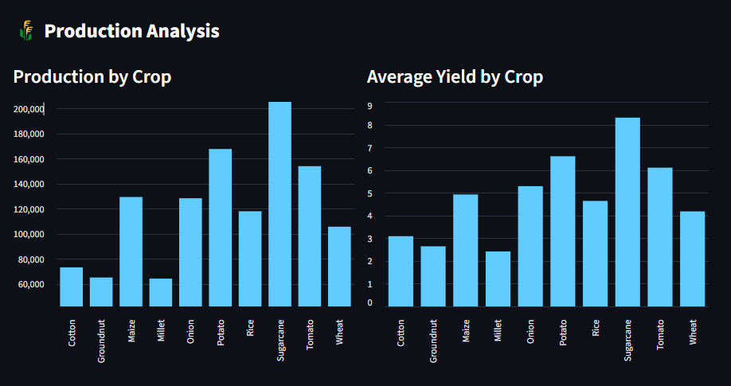
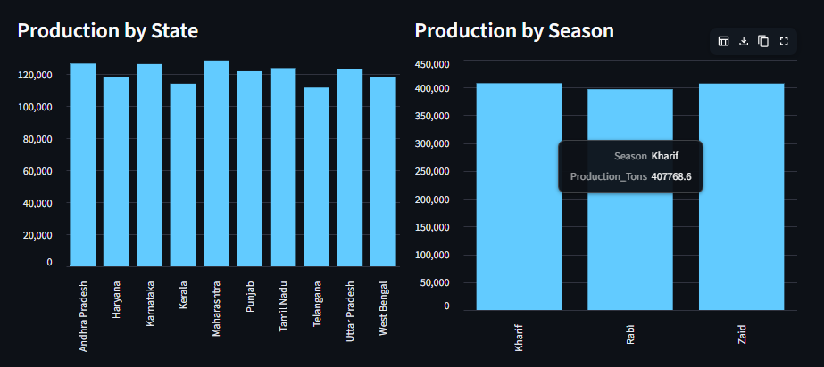
8. Exploratory Data Analysis
Production, yield, state and seasonal patterns are visualized for analytical interpretation.
HARIVATHANI A • Smart Agriculture Analytics • 9

Slide 10
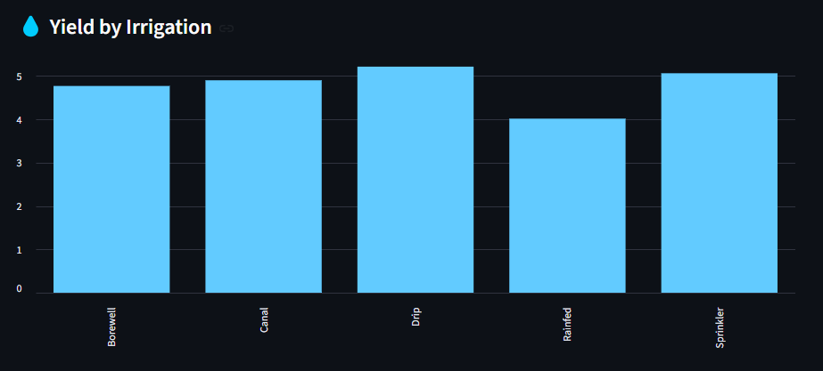
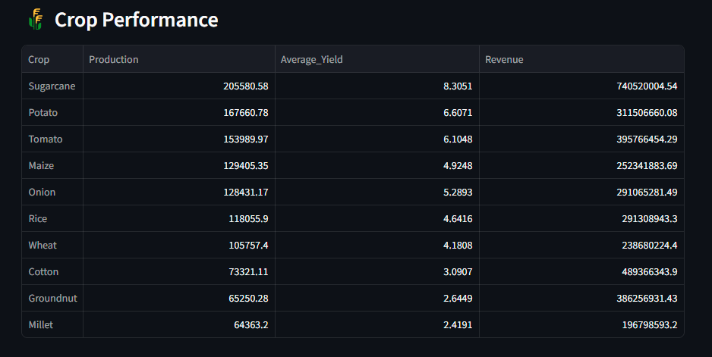
9. Analytical Insights
• Irrigation categories can be compared using average yield.
• Crop performance combines production, average yield and revenue.
HARIVATHANI A • Smart Agriculture Analytics • 10

Slide 11
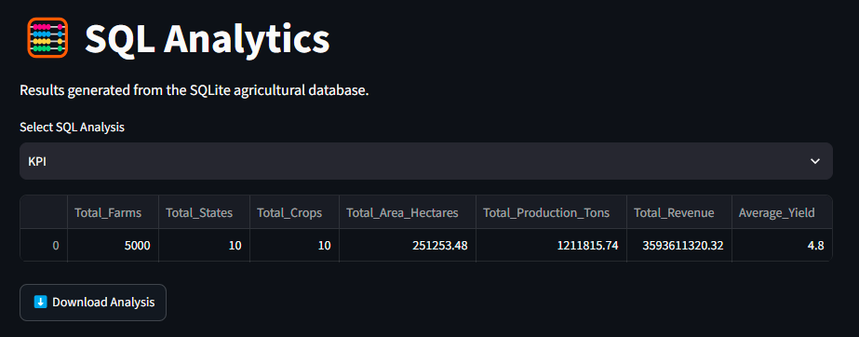
10. Database & SQL Analytics
• SQLite database stores the agricultural records and summary tables.
• 25 analytical SQL queries cover KPIs, crop, state, season and irrigation analysis.
• Results are exported to agriculture_sql_analysis.xlsx.
• Dashboard allows users to select and download SQL analysis.
HARIVATHANI A • Smart Agriculture Analytics • 11

Slide 12
11. Machine Learning Methodology
CLASSIFICATION
REGRESSION
Crop Recommendation
Yield Prediction
• Algorithm: Random Forest Classifier
• Inputs: N, P, K, temperature, humidity, rainfall, pH
• Output: Recommended crop
• Saved model: crop_recommendation_model.pkl
• Algorithm: Random Forest Regressor
• Inputs: area, weather, soil, fertilizer, pesticide, price, crop, season, irrigation
• Output: Yield in tons/hectare
• Saved model: yield_prediction_model.pkl
HARIVATHANI A • Smart Agriculture Analytics • 12

Slide 13
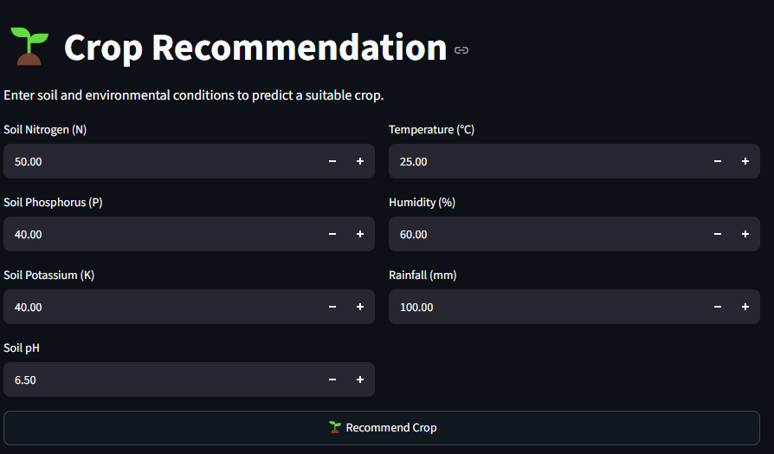
12. Crop Recommendation
• User enters soil and environmental conditions.
• The trained Random Forest classifier processes the inputs.
• The application returns a predicted crop category.
• Confusion matrix and feature-importance outputs support model analysis.
HARIVATHANI A • Smart Agriculture Analytics • 13

Slide 14
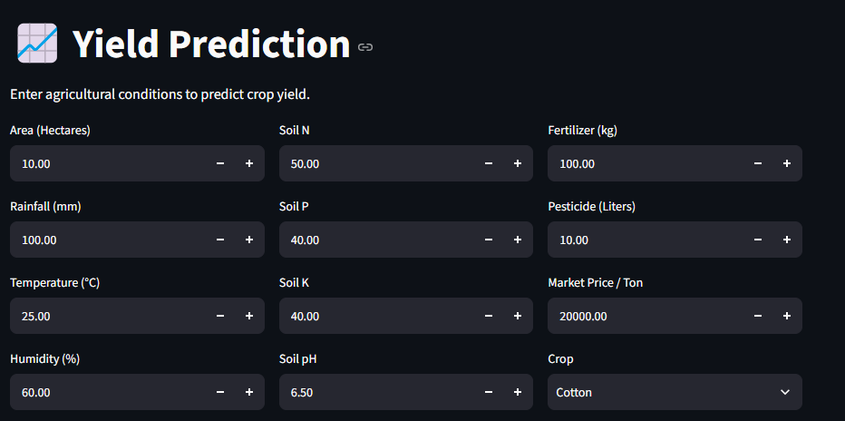
13. Yield Prediction
• User provides agricultural, soil, environmental and market inputs.
• Crop, season and irrigation are included as categorical features.
• Random Forest Regression predicts Yield_Tons_Per_Hectare.
• Actual-vs-predicted results are generated for model analysis.
HARIVATHANI A • Smart Agriculture Analytics • 14

Slide 15
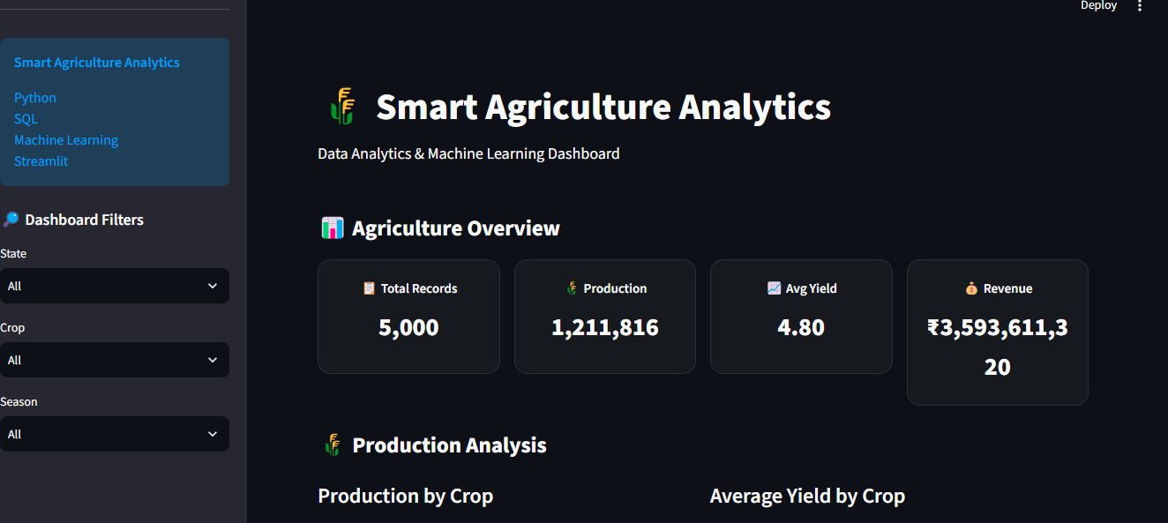
14. Streamlit Dashboard
HARIVATHANI A • Smart Agriculture Analytics • 15

Slide 16
15. Results
TOTAL RECORDS
PRODUCTION
AVERAGE YIELD
TOTAL REVENUE
5,000
1,211,816 Tons
4.80 T/Ha
₹3.59B
• The system successfully combines data preparation, visualization, SQL analytics and machine learning.
• The dashboard provides a single interface for analysis, recommendation, prediction and dataset exploration.
• Generated charts and serialized models are available as reusable project artifacts.
HARIVATHANI A • Smart Agriculture Analytics • 16

Slide 17
16. Conclusion & Future Enhancements
CONCLUSION
FUTURE ENHANCEMENTS
Integrated agricultural analytics
Towards smarter agriculture
• Successfully developed an end-to-end agriculture analytics platform.
• Integrated Python, SQL, machine learning and Streamlit.
• Implemented crop recommendation and yield prediction.
• Provided interactive analytical views.
• Real-time weather API integration
• IoT sensor integration
• Satellite-based crop monitoring
• Disease detection
• Fertilizer / irrigation recommendations
• Cloud and mobile deployment
HARIVATHANI A • Smart Agriculture Analytics • 17

Slide 18
THANK YOU
HARIVATHANI A
MSc Computer Science
Madurai Kamaraj University

